Slide 1
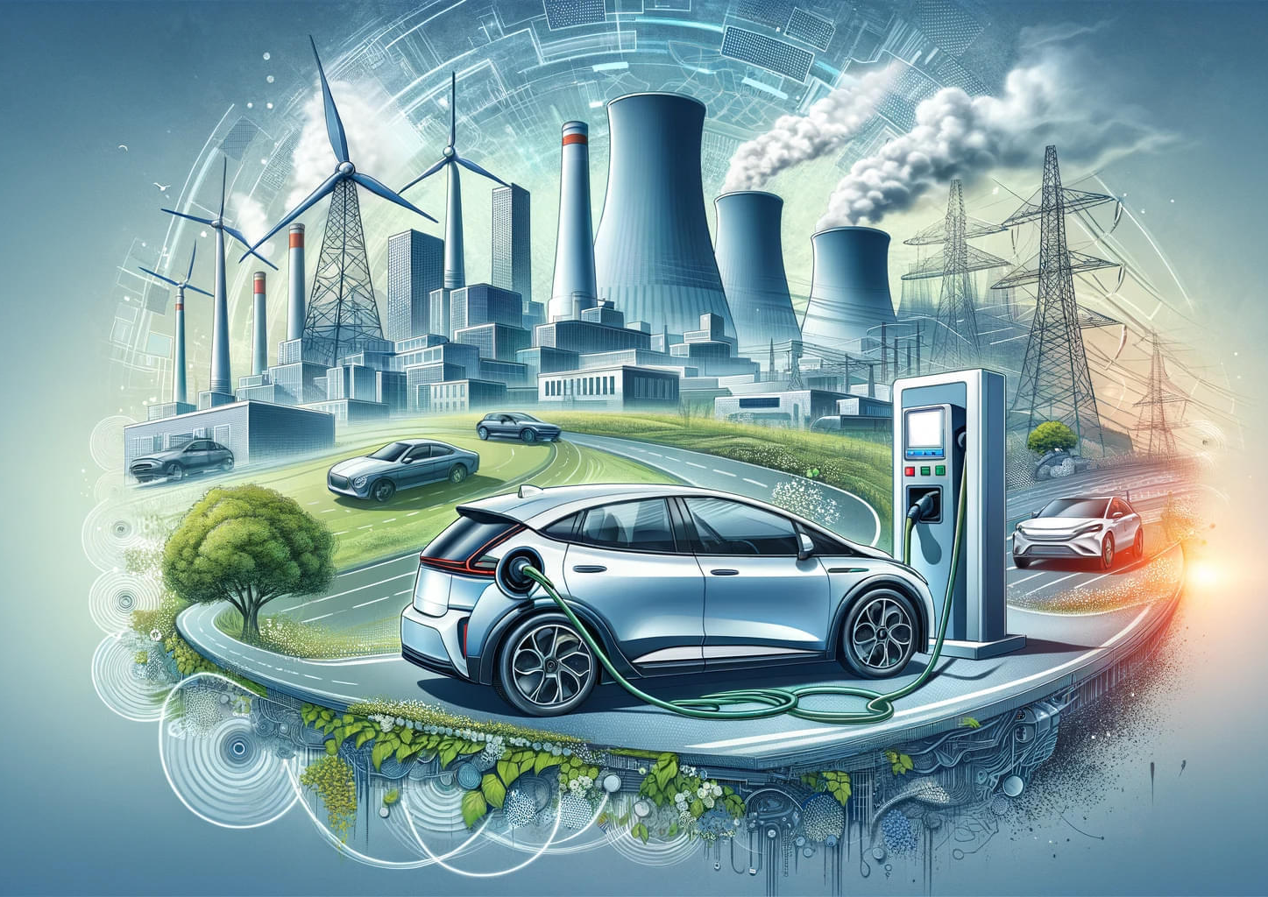
Powering Electric Vehicles: The CO2 Emissions You Don't See
CSIT Data Science Project
Professor: Dr. Jiayin Wang
Group members: Aziz, Ola, Xu

Slide 2

Background
Electric Vehicles produce CO2
Consumption of electricity has lifecycle CO2 emissions
Electric Power Sources Matters
Geographical Variations

Slide 3

Section 1: Data Source and Preprocessing

Slide 4

State Electricity Generation by Fuel Type
Title: NEI Data on State Electricity Generation
Website: NEI Resources
Brief Description: Percentage of electricity generated from different fuel types (nuclear, coal, natural gas, renewables, etc.) across all 50 states.

Slide 5

CO2 Lifecycle Emissions by Power Source
Title: World Nuclear Association on CO2 Emissions
Website: World Nuclear Association
Brief Description: Comprehensive data detailing CO2 emissions metrics for various types of power plants, including coal, nuclear, solar, and wind.

Slide 6
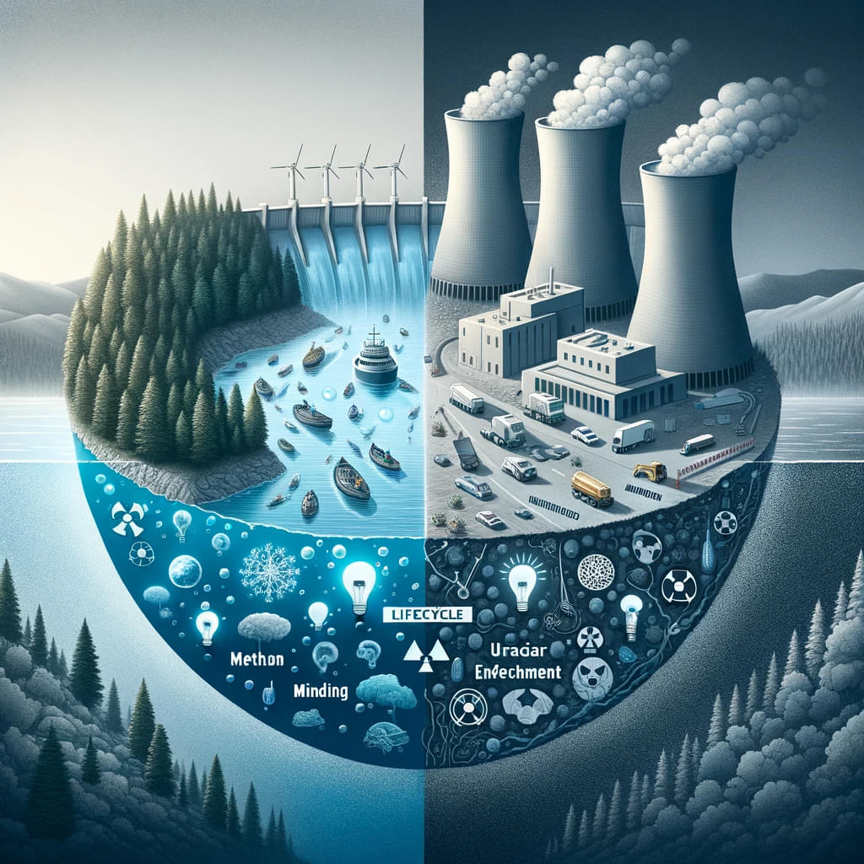
What about Nuclear and Hydro?
Hydroelectric Power
Construction Emissions
Land Use and Methane Emissions:
Nuclear Power
Fuel Production Emissions
Long-term Waste Management

Slide 7

Electricity Consumption of EVs and Driver Mileage Data
Electricity Consumption Data Source:
Source: SunPower
Brief Description: This article provides data on the average electricity consumption rates for electric vehicles, crucial for assessing their energy use per mile.
Average Mileage Data Source:
Source: PolicyGenius
Brief Description: This article offers detailed statistics on the average annual mileage driven by vehicle owners across each state, essential for calculating total annual electricity usage of EVs.

Slide 8
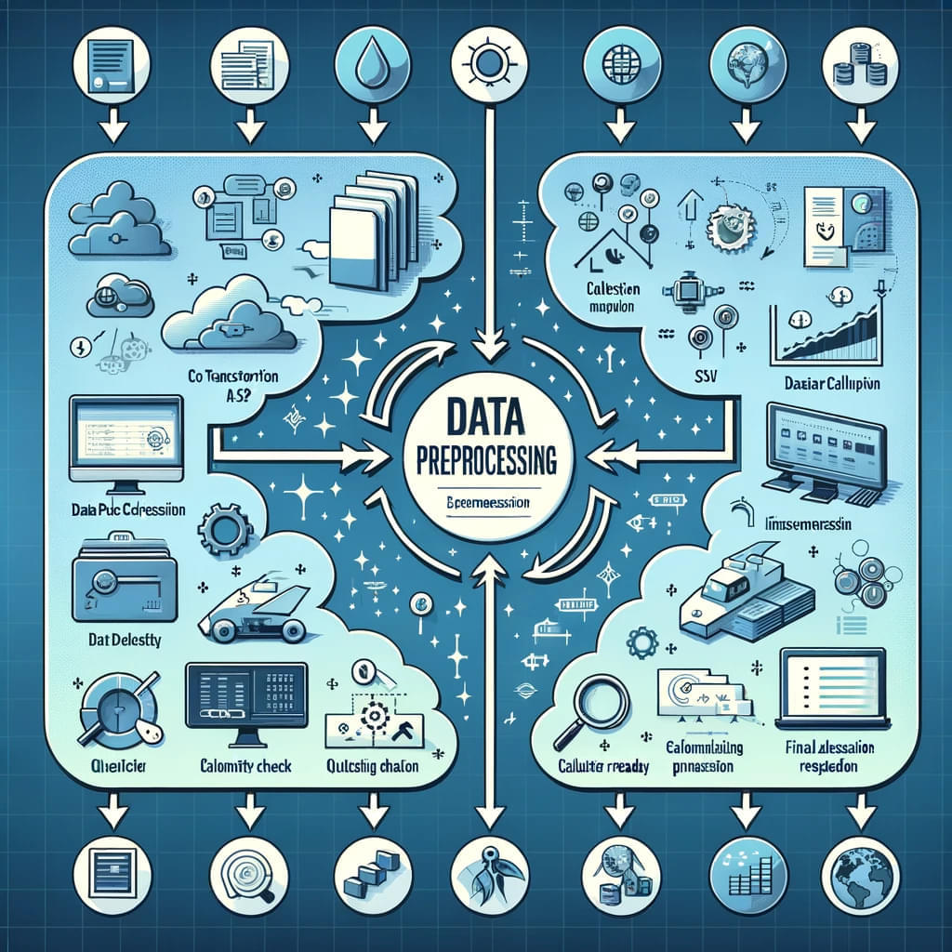
Preprocessing
Collecting Data:
Gather data from various sources on electricity generation, CO2 emissions, and EV usage across different states.
Converting Data:
Transform all collected data into CSV format for easier analysis.
Calculating Key Metrics:
CO2 Emissions per kWh: Calculate how much CO2 is emitted per kWh by different power plants.
Average Emissions per Driver: Determine the potential CO2 emissions based on average mileage per driver in each state.

Slide 9
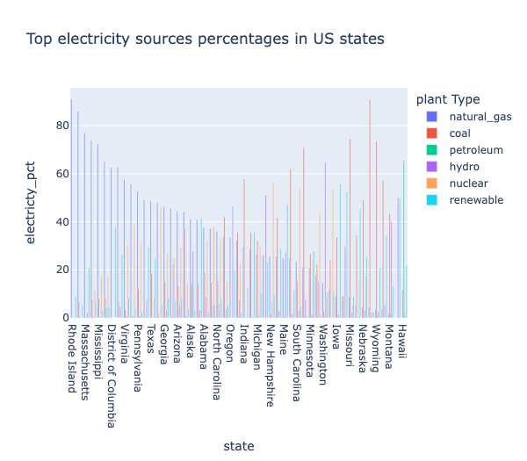
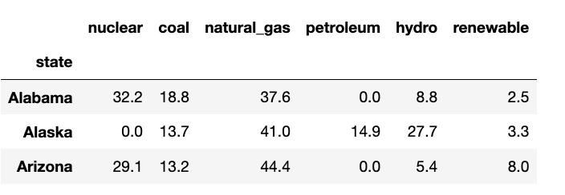
ENERGY SOURCES
Rhode Island scored the highest percentage of electricity energy source which is Natural Gas

Slide 10
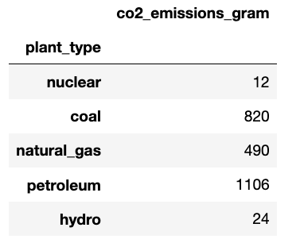
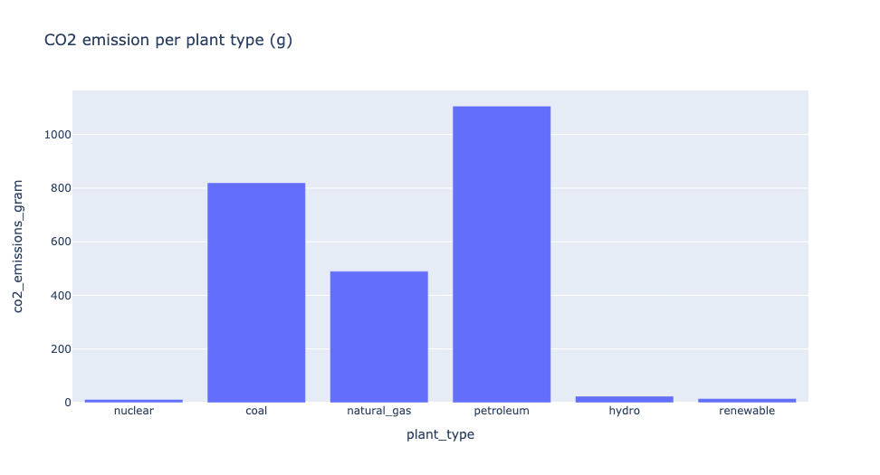
CO2 EMISSION PER ENERGY SOURCE
Petroleum is the energy source with the highest CO2 Emission per kWh

Slide 11
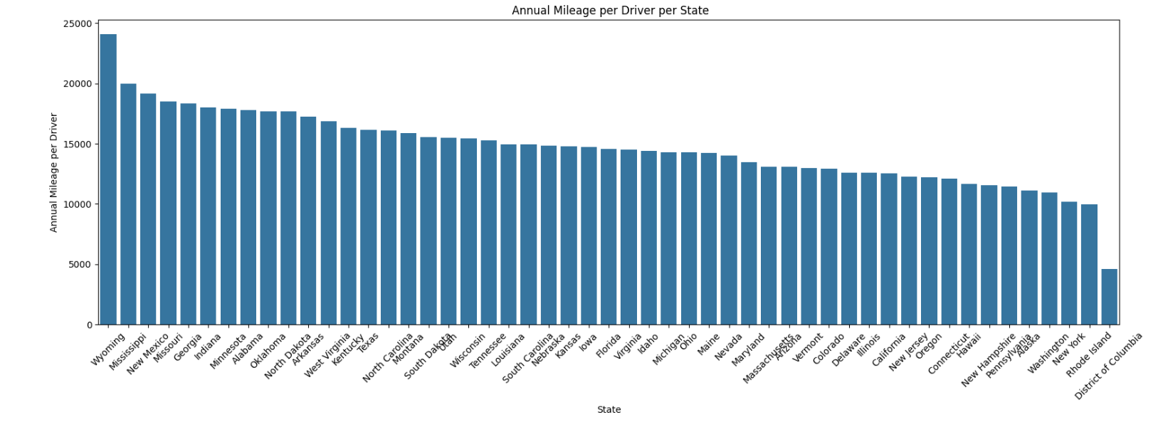
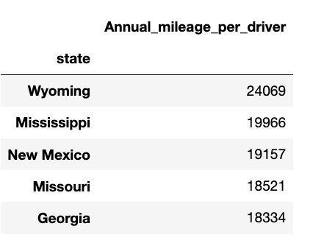
DRIVERS MILLAGE
Wyoming is the state with the highest number of vehicles annual millage.

Slide 12

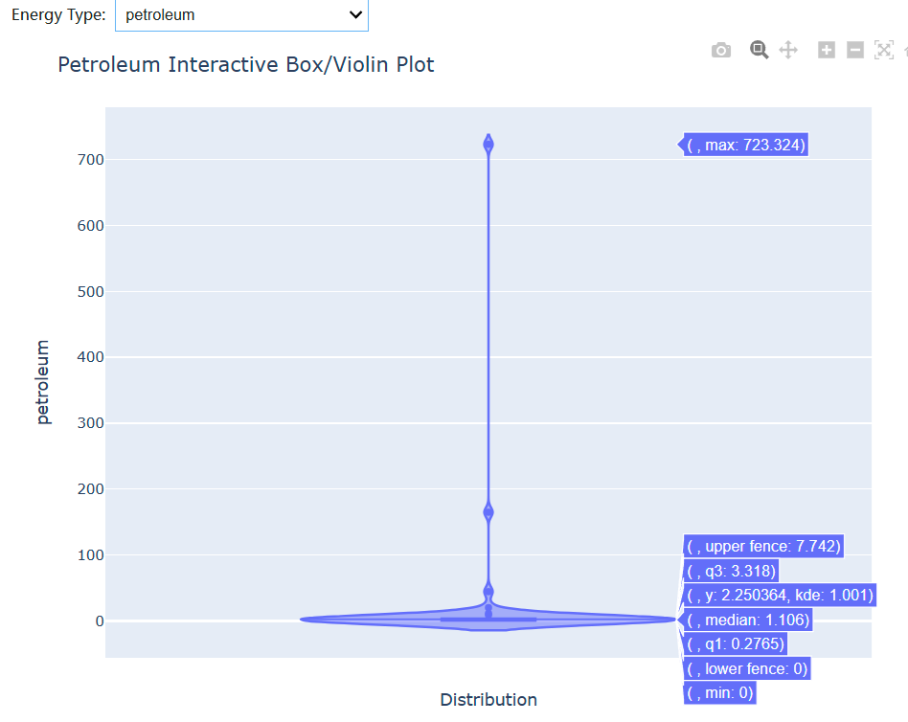
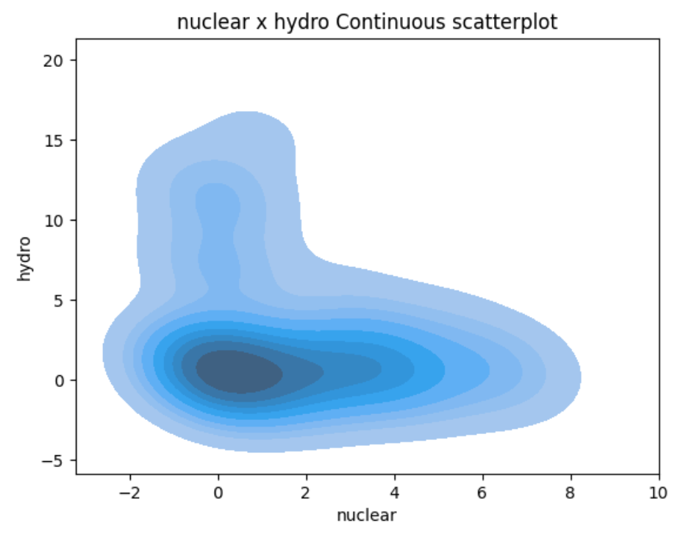
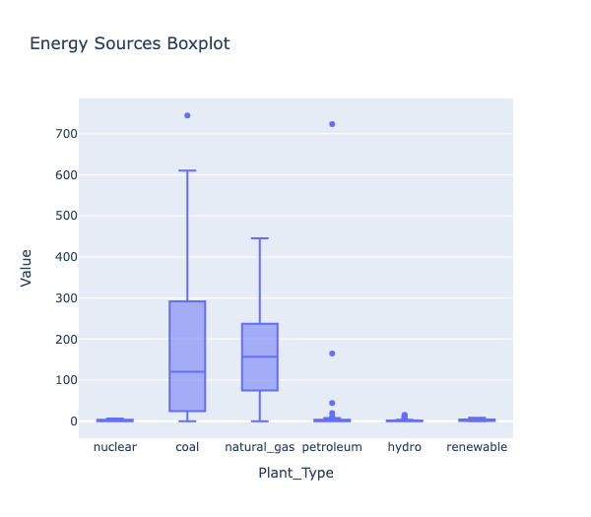
electricity sources % STATISTICAL SUMMARY

Slide 13
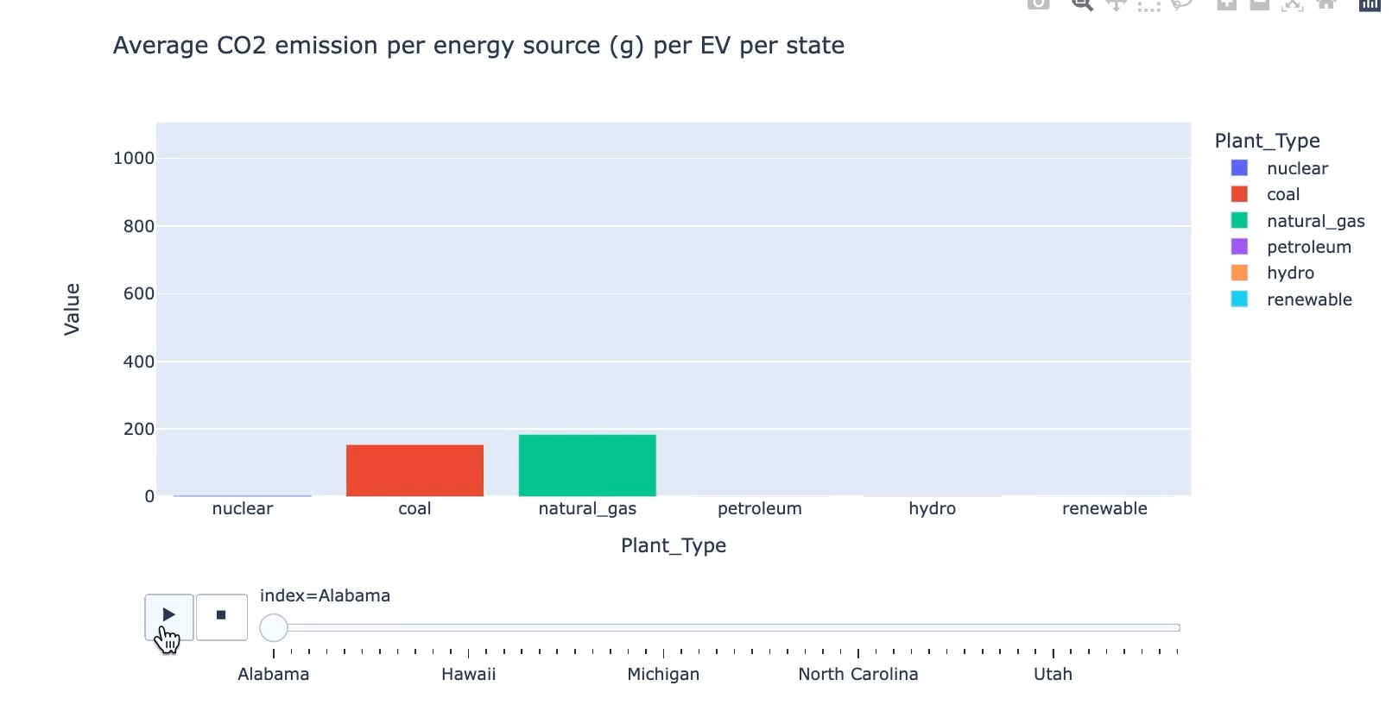
WHICH ENERGY SOURCE DOES EACH STATE USE THE MOST?

Slide 14
Map Visualization
Bubble Map(Interactive-2/2)
Choropleth Map

Slide 15
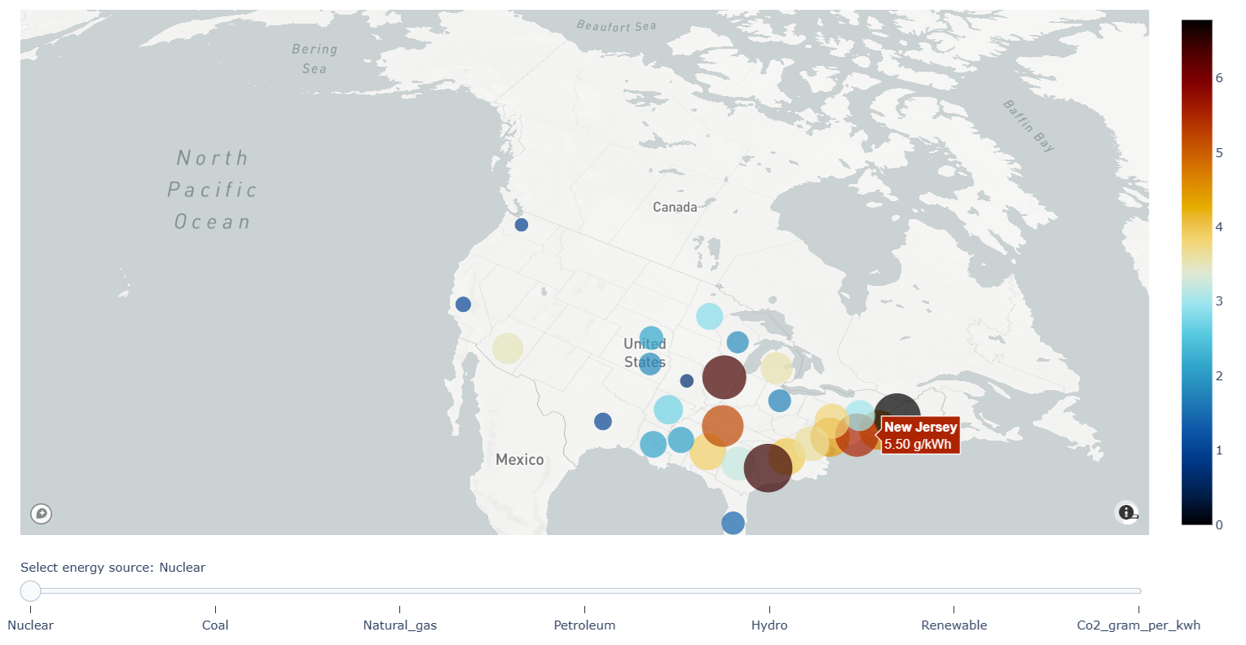
NUCLEAR CO2 EMISSION Per Kwh

Slide 16
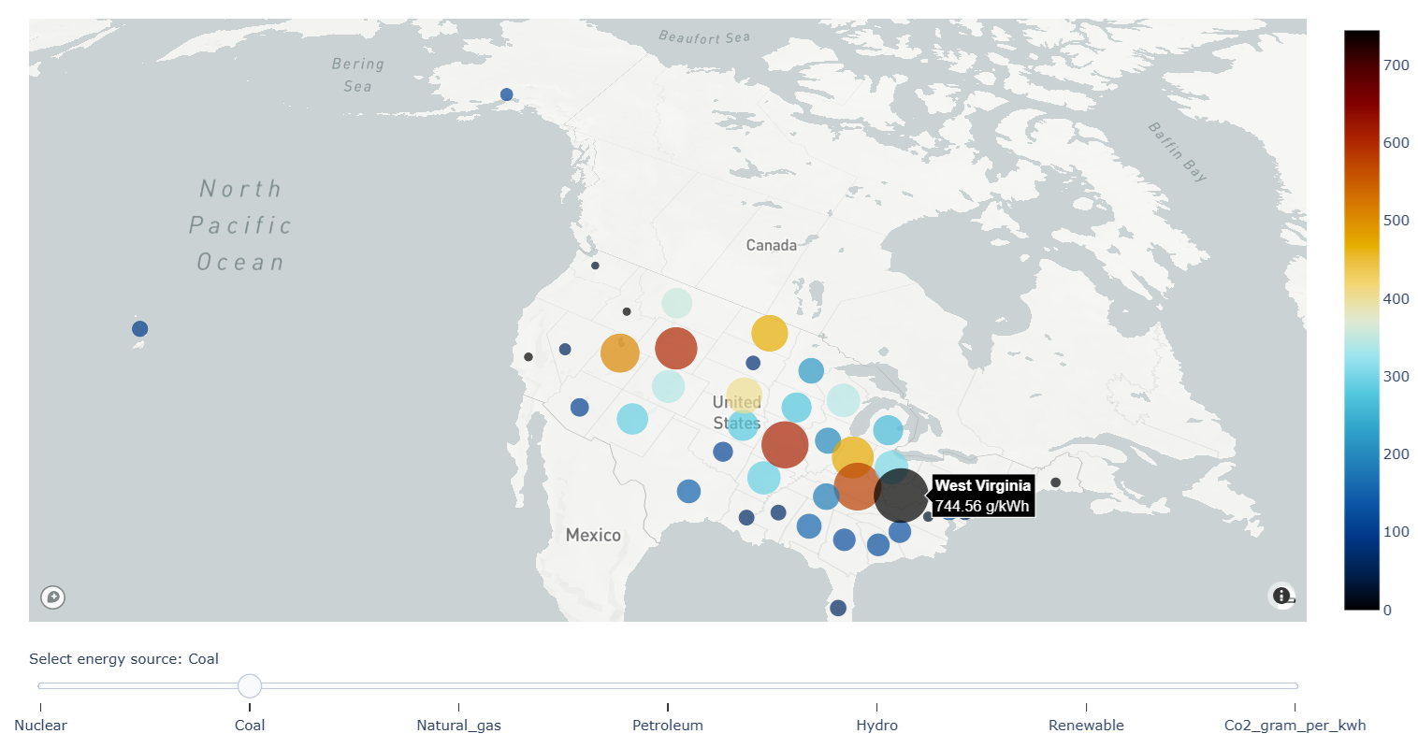
COAL CO2 EMISSION Per Kwh

Slide 17
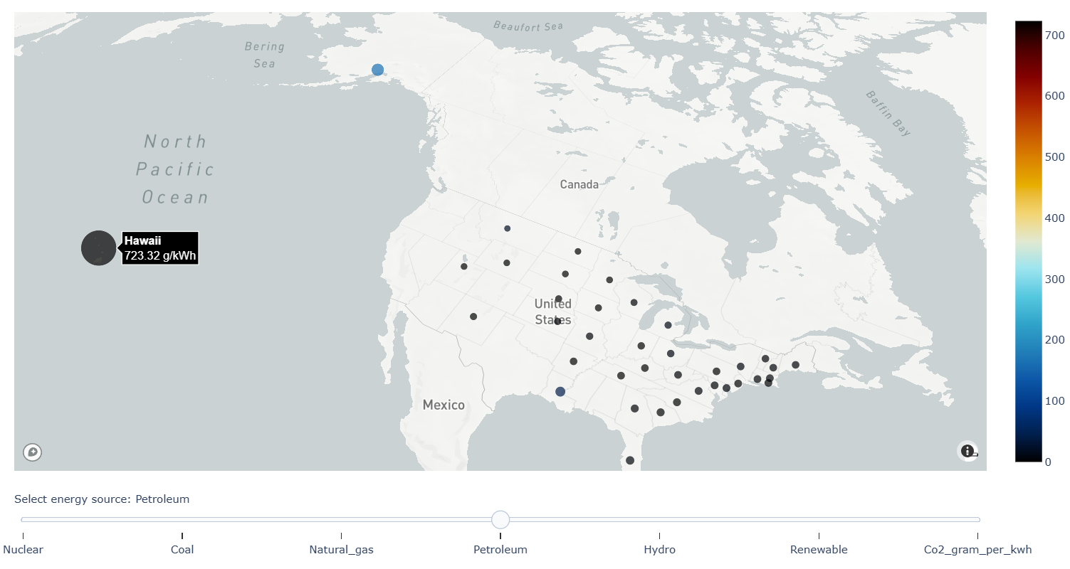
PETROLEUM CO2 EMISSION Per Kwh

Slide 18

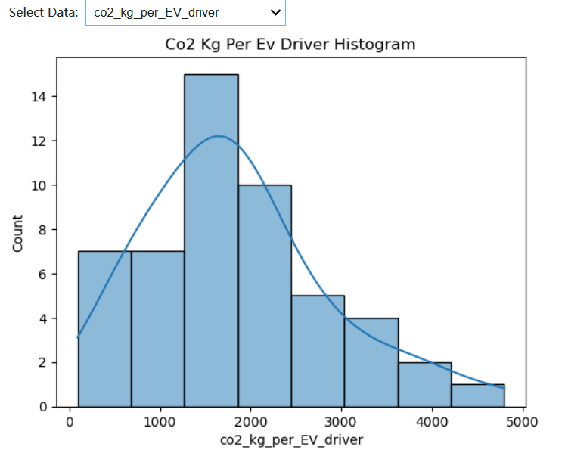
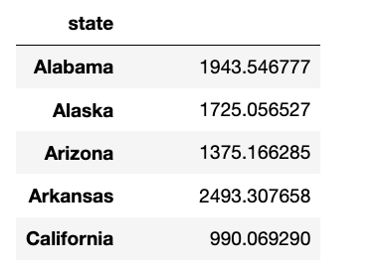
CO2 EMISSION Per EV
Histogram/Density plot

Slide 19
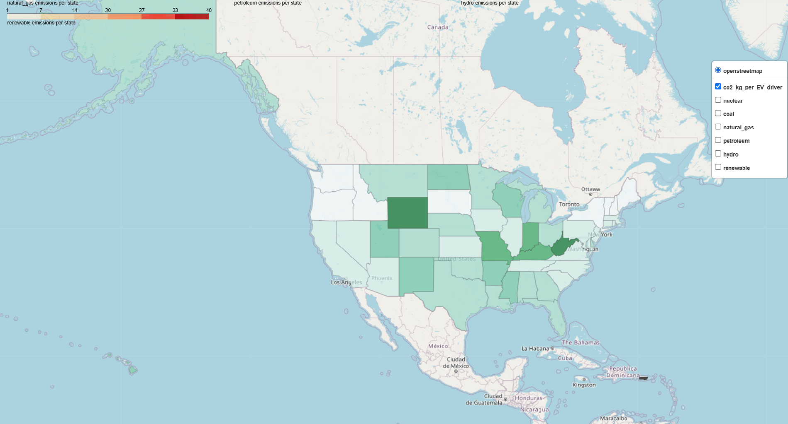
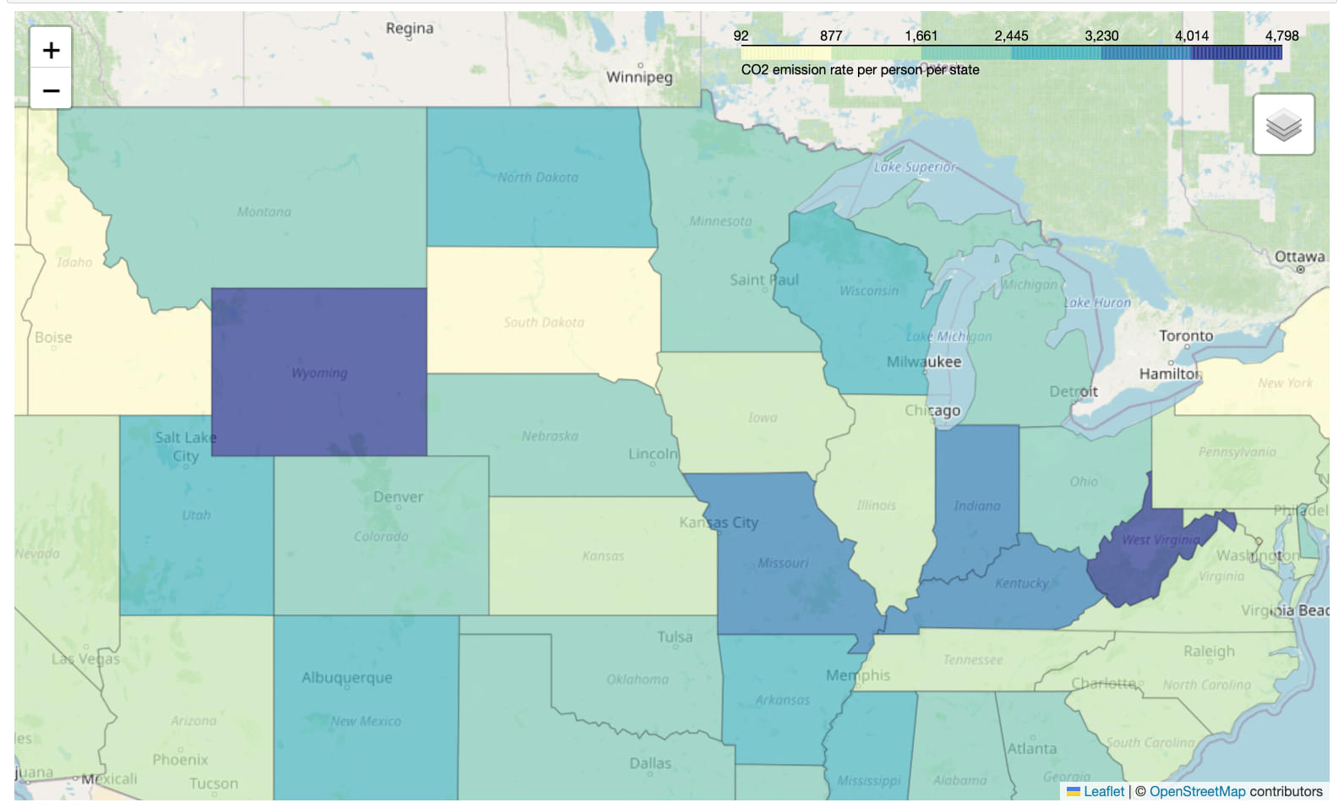
CO2 EMISSION BY PERSON PER STATE

Slide 20
Conclusion
Petroleum Power Plants: Although petroleum power plants are less common across the United States, they are significant contributors to CO2 emissions in specific regions, particularly in Hawaii and Alaska. These areas rely more heavily on petroleum due to geographic and infrastructural constraints, leading to higher localized emissions.
Coal as a Primary Emitter: Coal remains the predominant source of CO2 emissions nationwide, due to its extensive use in electricity generation. The high carbon content of coal results in greater CO2 emissions per unit of energy produced compared to other fossil fuels.
Impact of Clean Energy Sources: States with higher percentages of hydro, nuclear, and renewable energy generation typically exhibit lower CO2 emissions. These energy sources are cleaner alternatives that produce little to no direct CO2 emissions, thereby contributing to a more sustainable energy profile and aiding in the reduction of overall greenhouse gas emissions.

Slide 21
Limitations and Possible Improvements
Temperature Influence on EV Battery Efficiency and lifespan
EV Battery Lifecycle CO2 emission
Electric Source and Geographic Variability
EV efficiency improvement(0.32kwh per mile now)

